Slide 1
Global Harmful Gas Emissions
Ami Doshi
Abhinav Sharma

Slide 2
Problem
Currently, there is a lack of open-for-all data regarding to Harmful Gas Emissions on a global level. There is no system in place for people around the world to be allowed to see and realize how harmful some gases are and what effects they may have on their lives and the environment around them
If there was an easily usable interface that could provide such data to a layman user as well as researchers, it may help them to spread awareness and generate actionable insights for reducing the levels of harmful gases in the environment.

Slide 3
Objective
Find different kinds of harmful gasses present in the environment with respect to specific countries and the effect they can have on the environment and its members i.e. Humans, Animals, Water bodies, Ozone layer, Marine life, Land, etc.
Identify what solutions the country with high harmful gas emissions can put in place to help reduce its carbon emissions.
To narrow down the scope and better help the countries at risk to identify their harmful gas emission risks and its effects on health of humans, animals, marine life and Ozone layer, we will be specifically focusing on Carbon Dioxide, Carbon Monoxide, Sulphur Dioxide, Nitrogen Dioxide and CFC gases for harmful gas emissions.

Slide 4
The solution
We have designed a database that can hold data about different countries, gases, their hazard levels, their harmful effects on people & environment and the solutions that can help countries deal with such problem.
An interface has been created with the help of forms which provide the Country-wise and Gas-wise Data
Currently, no global system, just for specific countries
No login Interface, just viewing rights so it can be open for all
With the help of this database, we were able to create a report which highlights the death toll in each country due to different harmful gases.

Slide 5

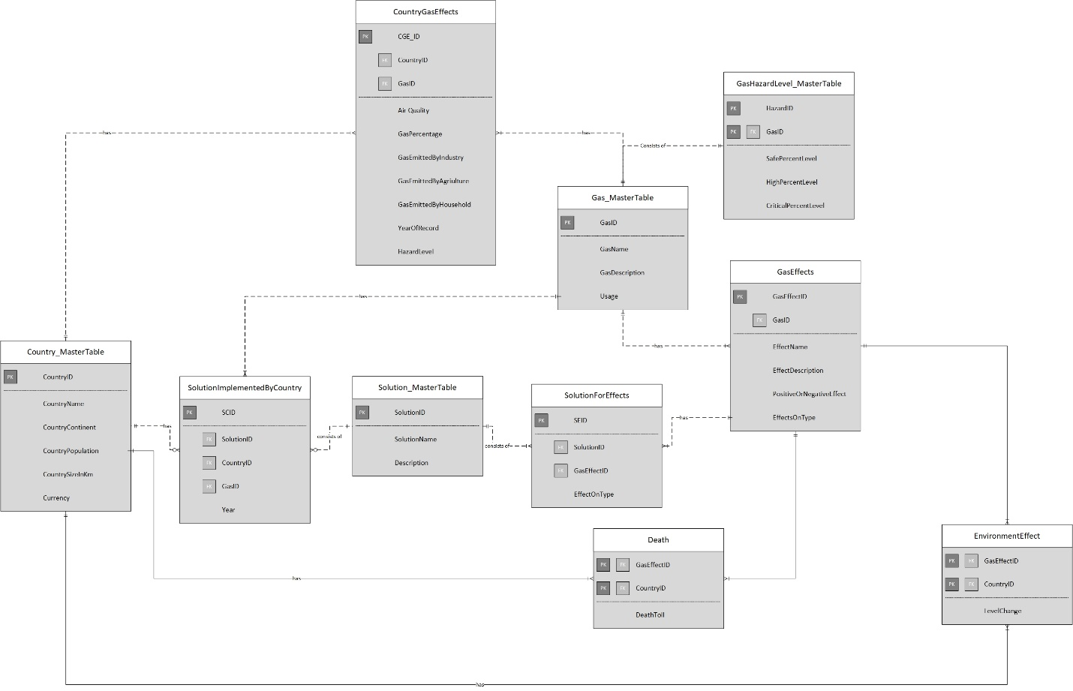

ER Diagram
List of Tables:
Country_MasterTable
Gas_MasterTable
Solution_MasterTable
GasEffects
GasHazardLevel
EnvironmentEffect
Death
SolutionForEffects
SolutionImplementedByCountry
CountryGasEffects

Slide 6
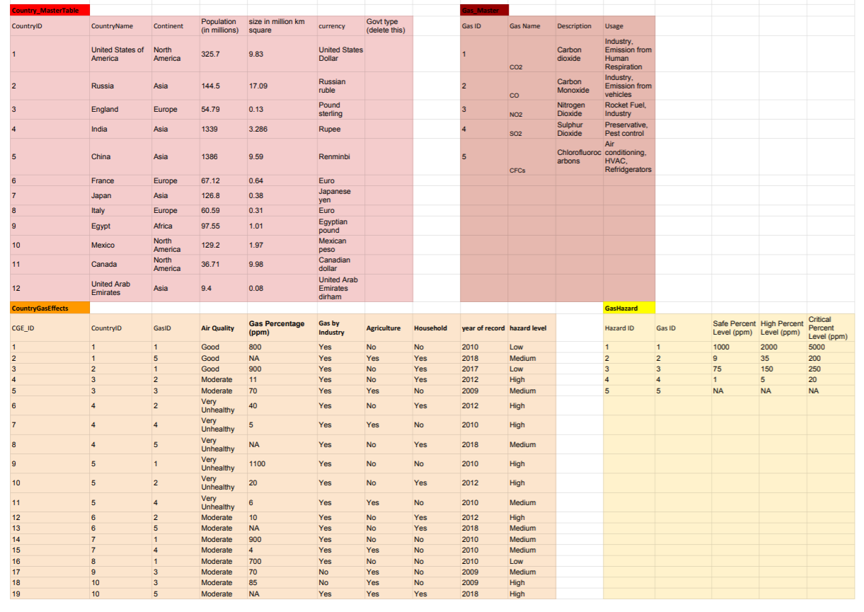
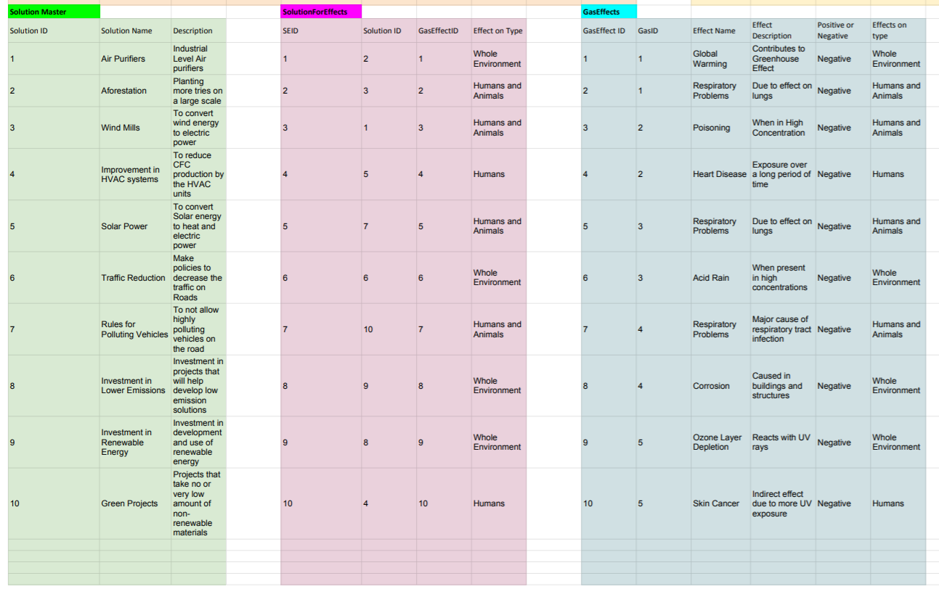
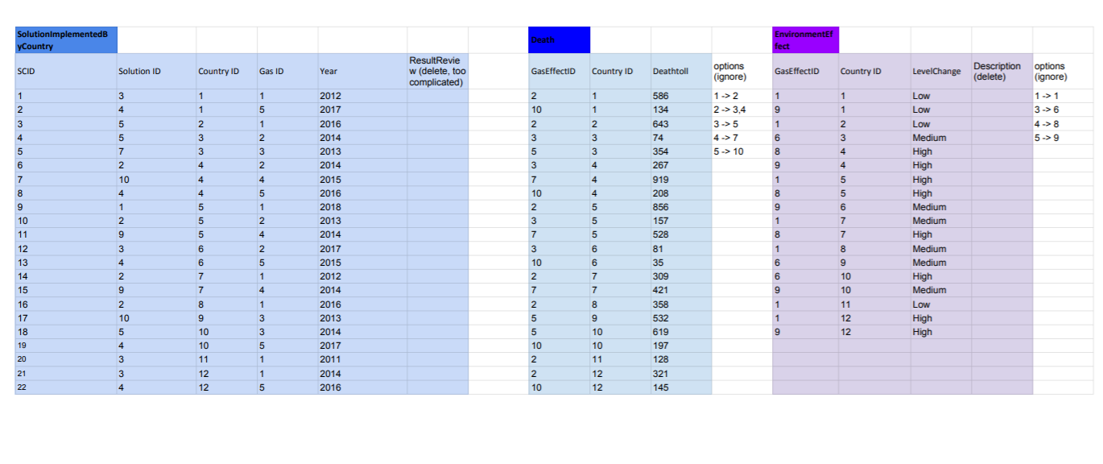

Slide 7
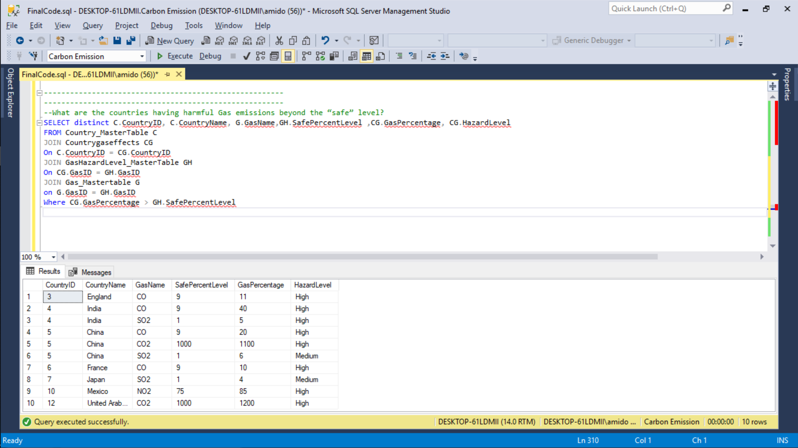
Data Questions
What are the countries having harmful gas emissions beyond the “safe” levels?

Slide 8
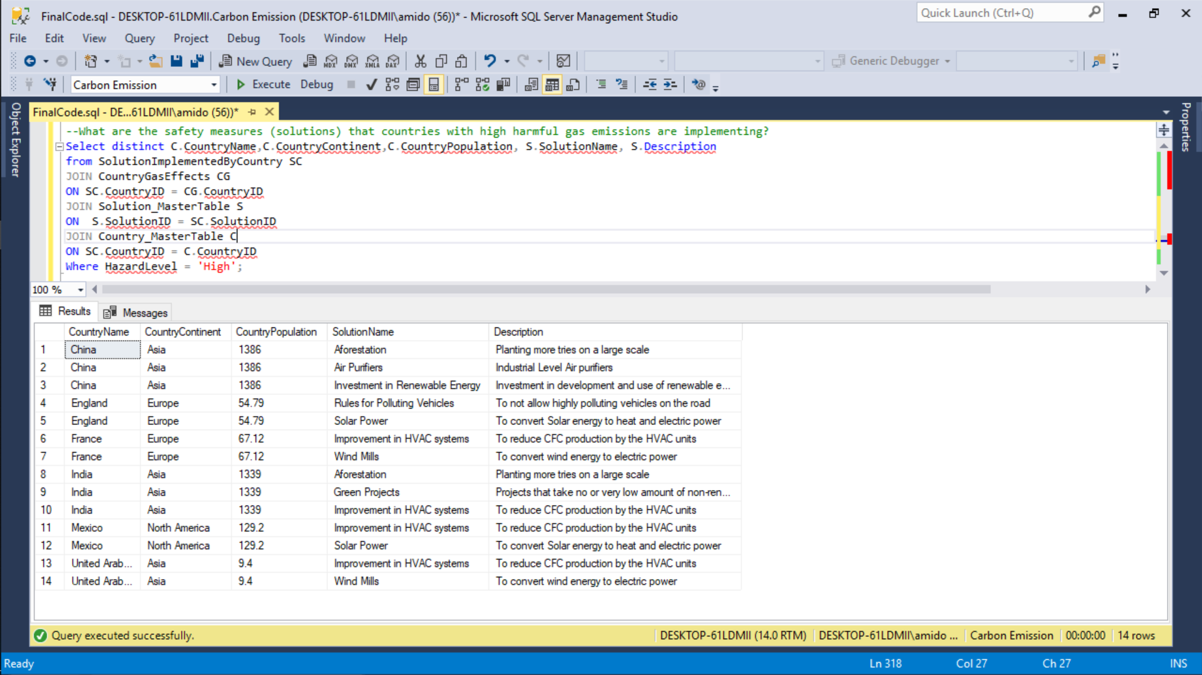
Data Questions
What are the safety measures (solutions) that countries with high harmful gas emissions are implementing?

Slide 9
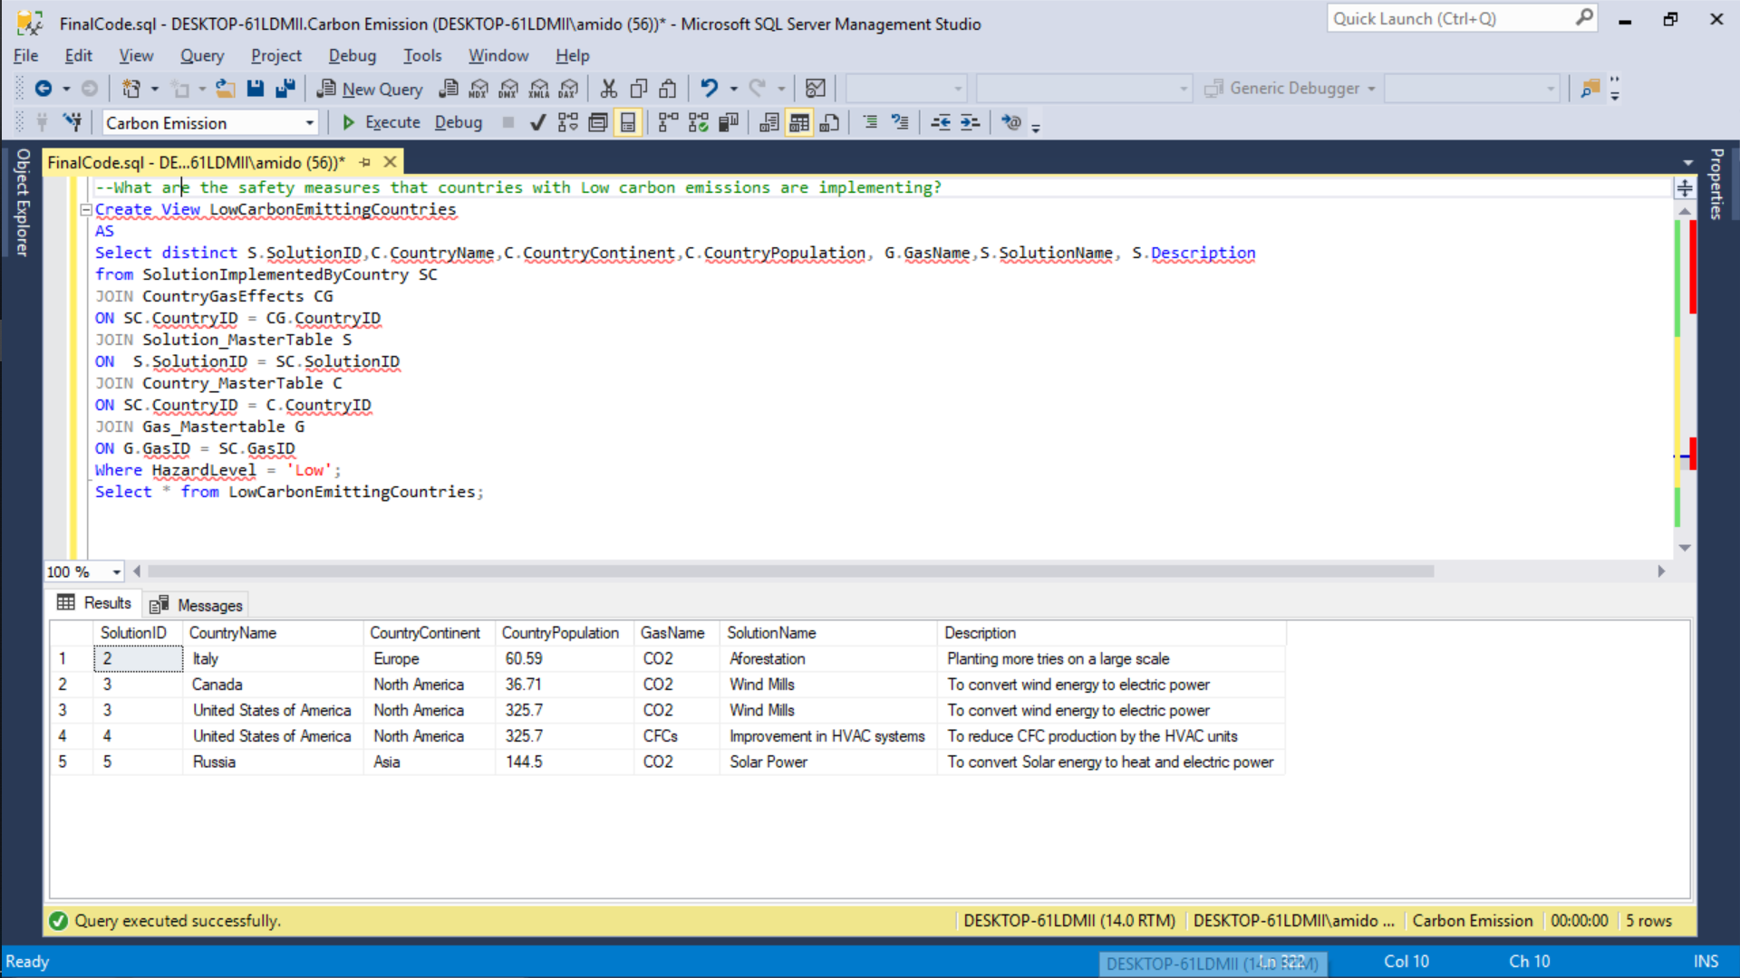
Data Questions
What are the safety measures (solutions) that countries with low harmful gas emissions are implementing?

Slide 10
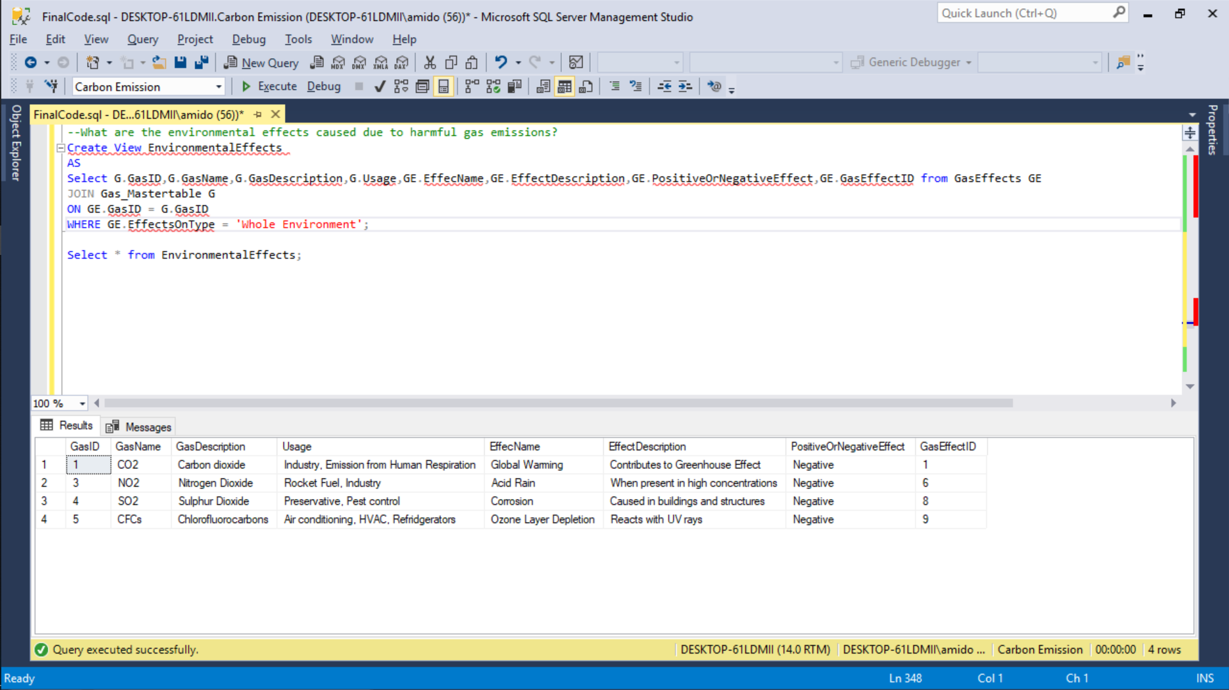
Data Questions
What are the environmental effects caused due to harmful gas emissions?

Slide 11
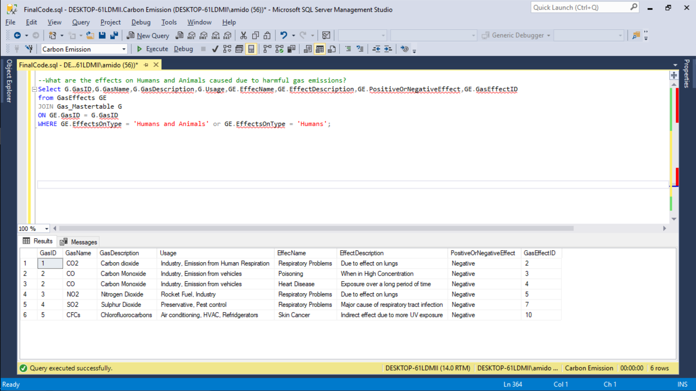
Data Questions
What are the effects on Humans and Animals caused due to harmful gas emissions?

Slide 12
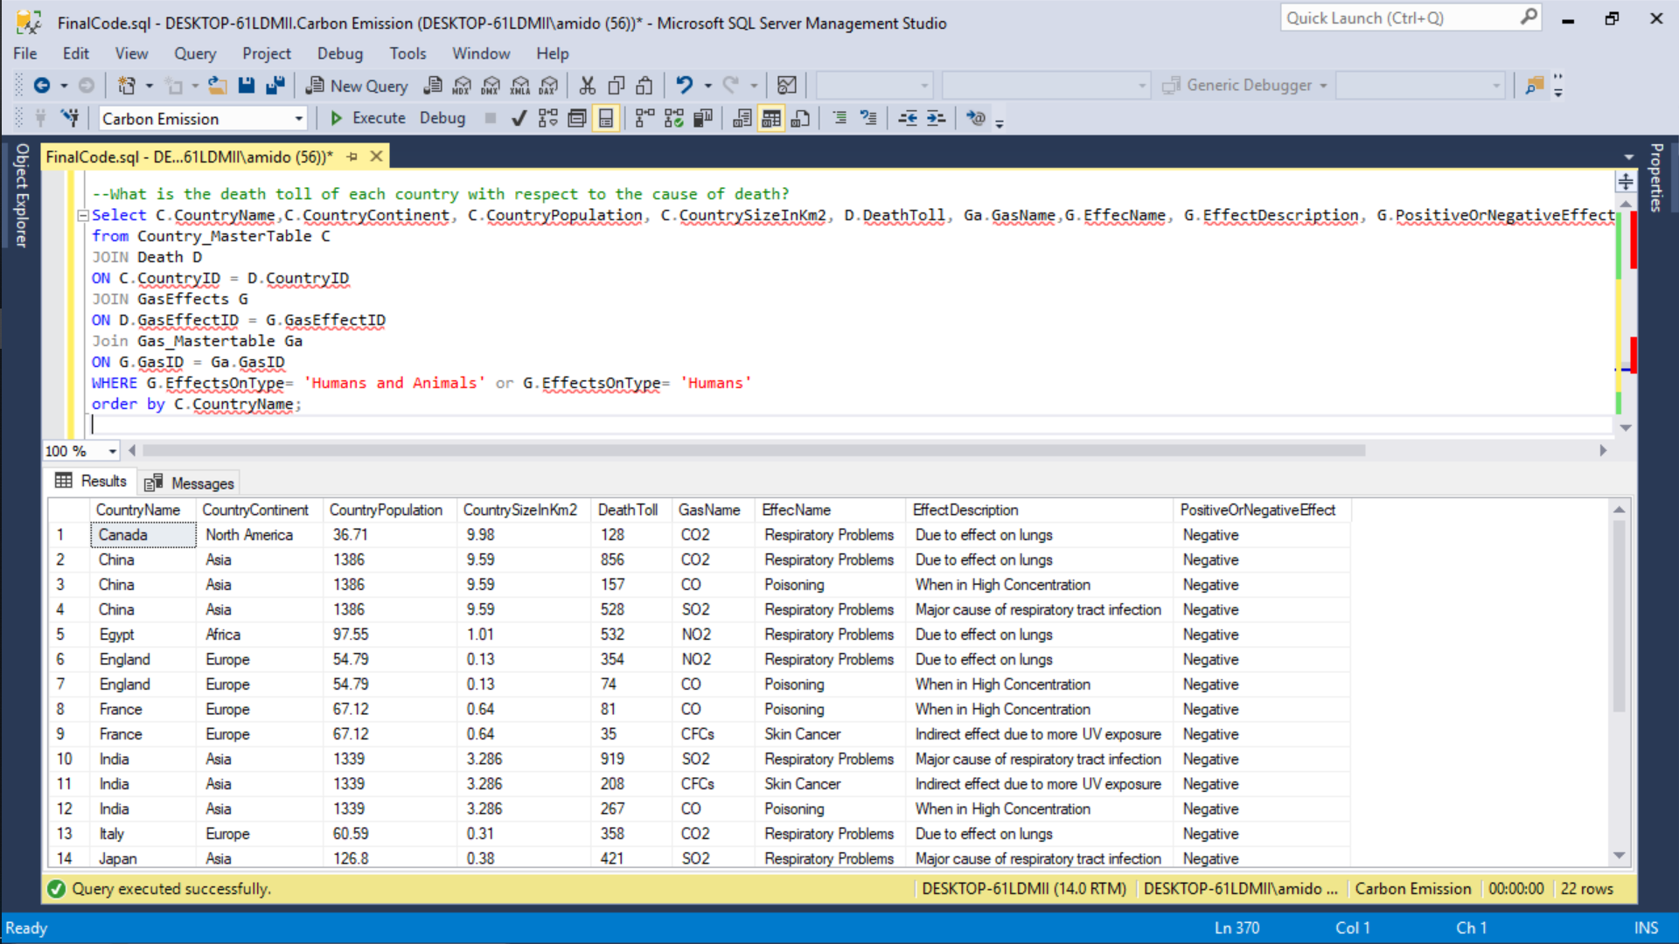
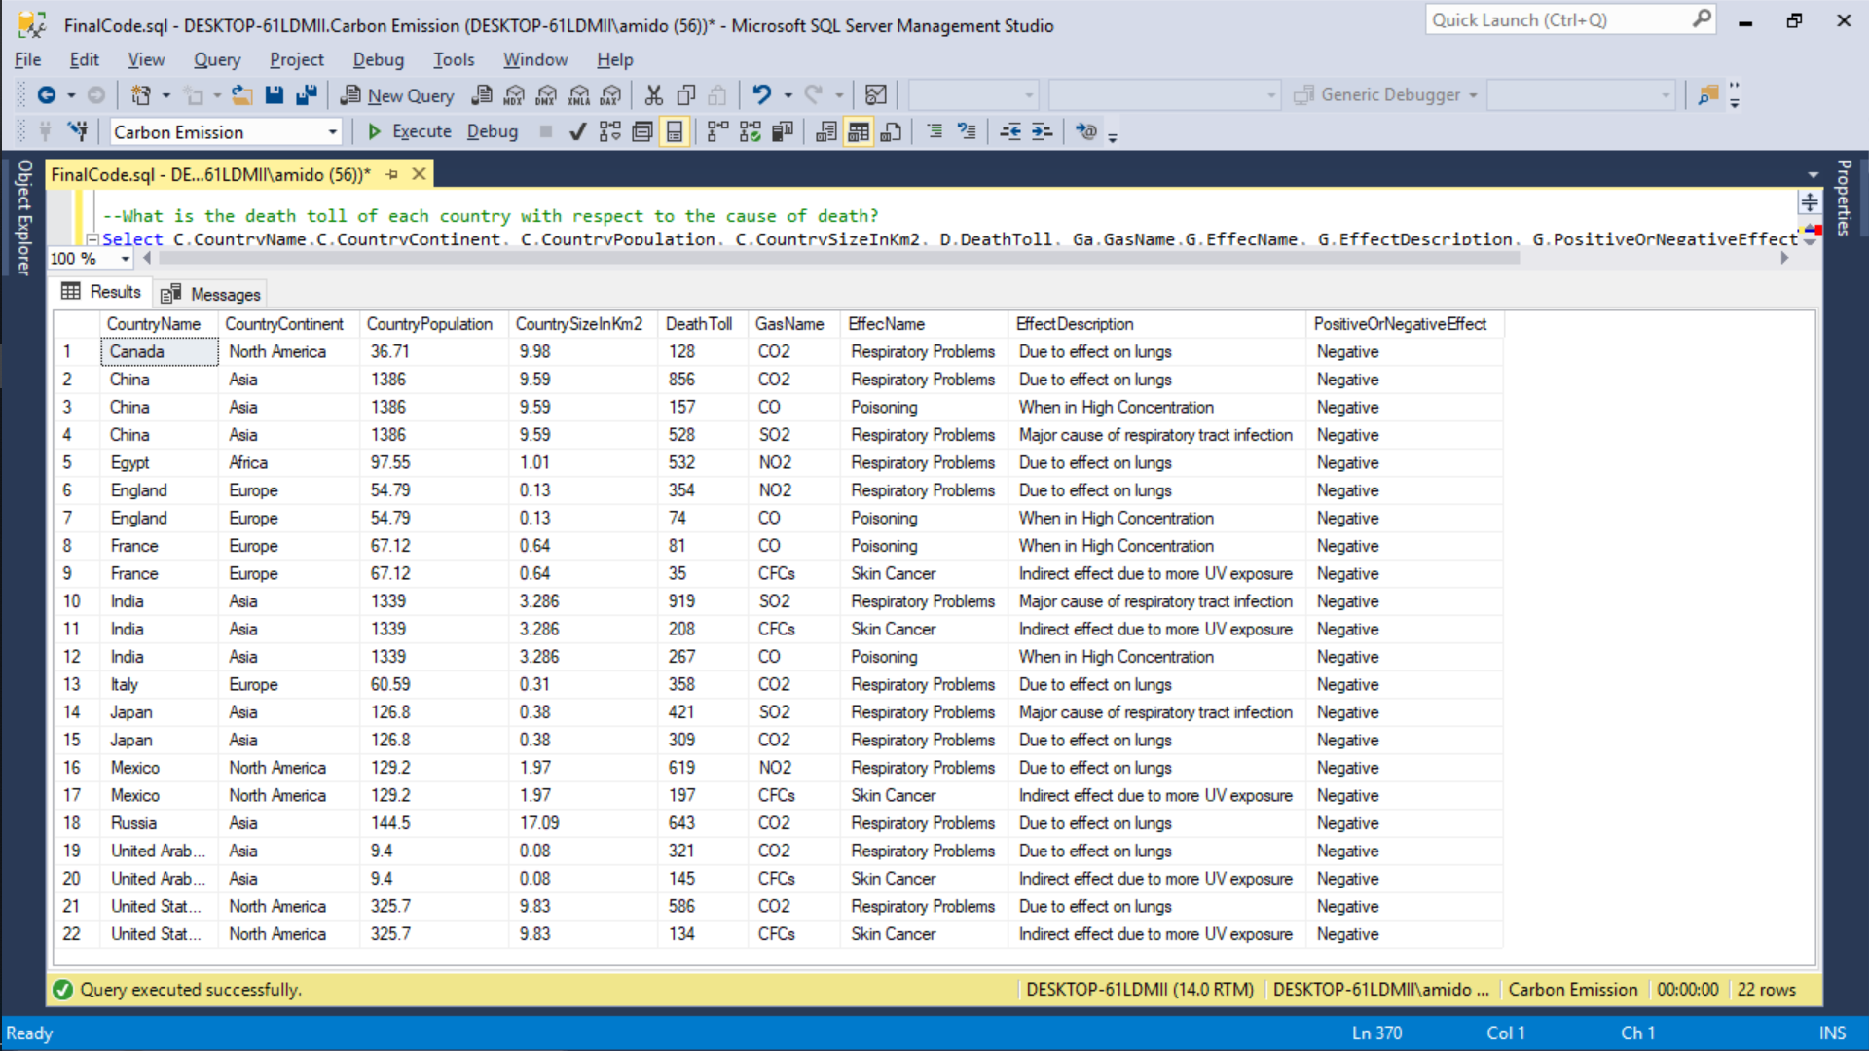
Data Questions
What is the death toll of each country with respect to the cause of death?

Slide 13
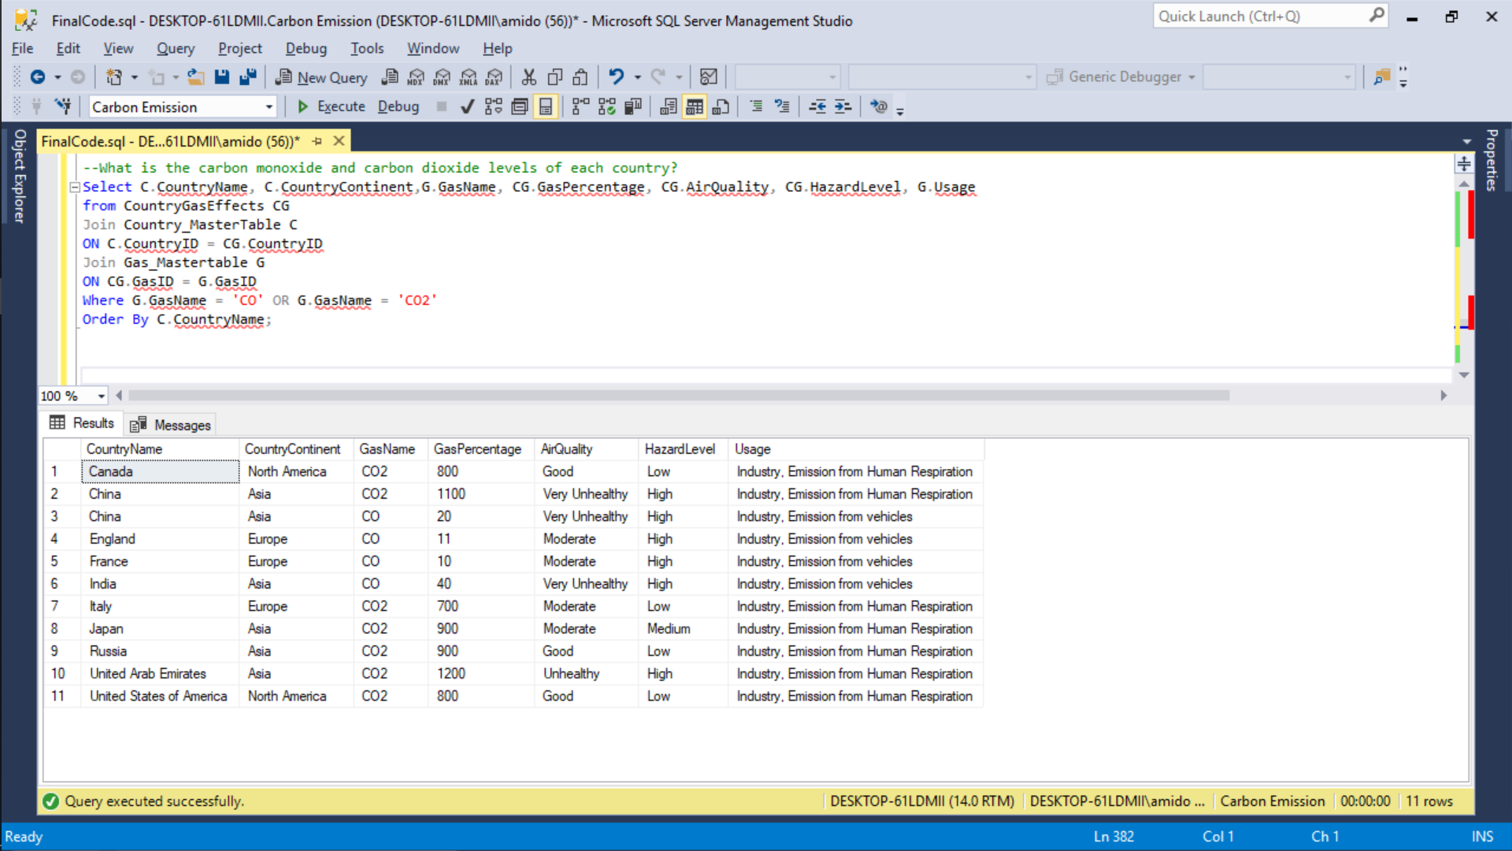
Data Questions
What is the carbon monoxide and carbon dioxide levels of each country?

Slide 14
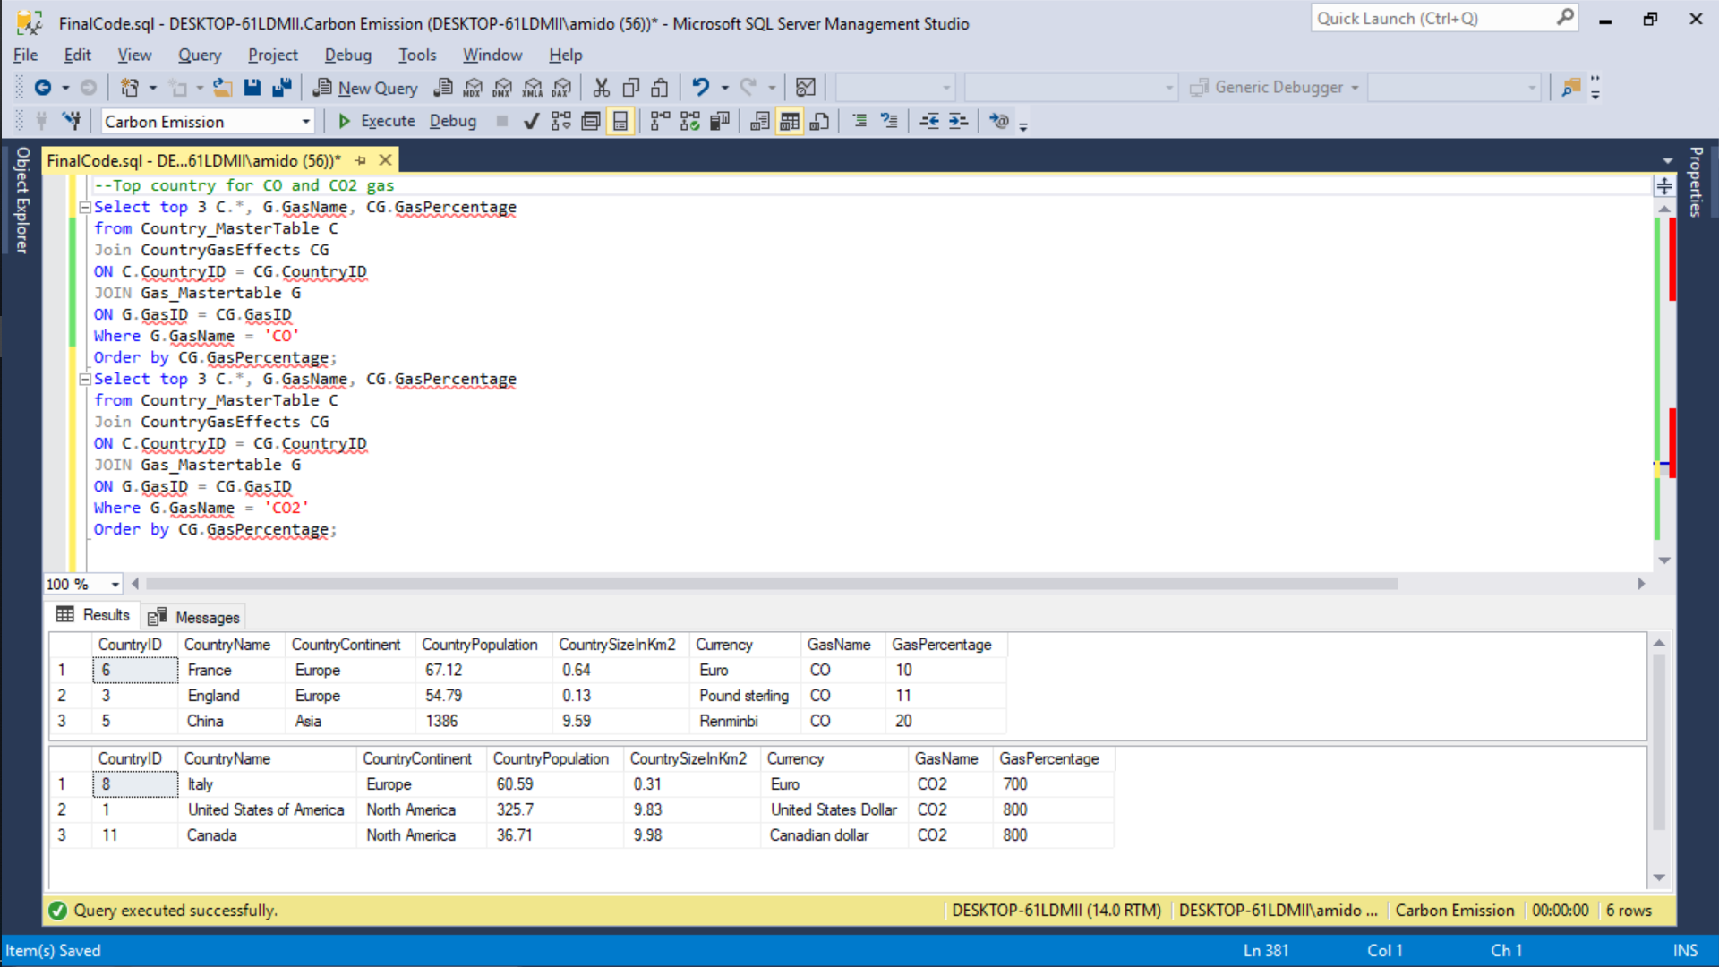
Data Questions
Top country for CO and CO2 gas

Slide 15
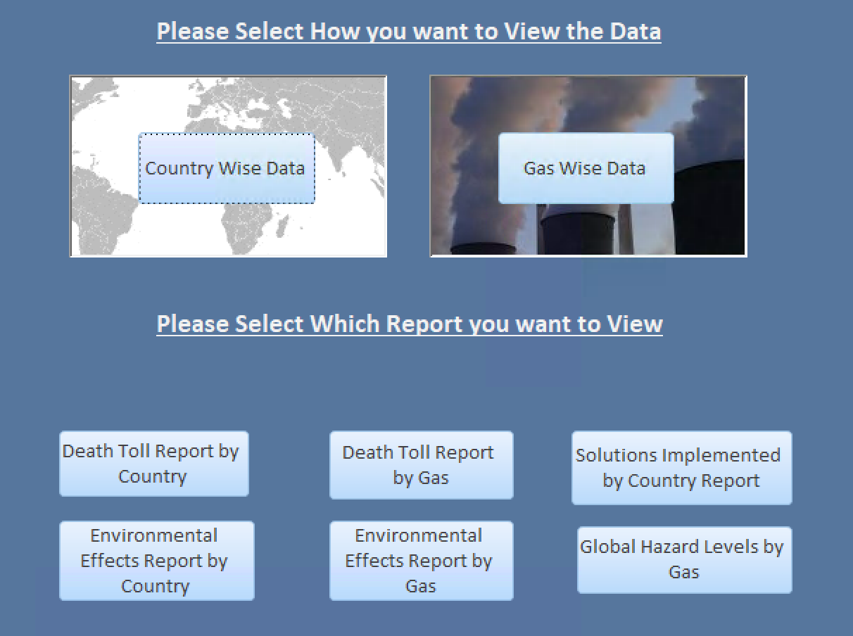
Interface

Slide 16
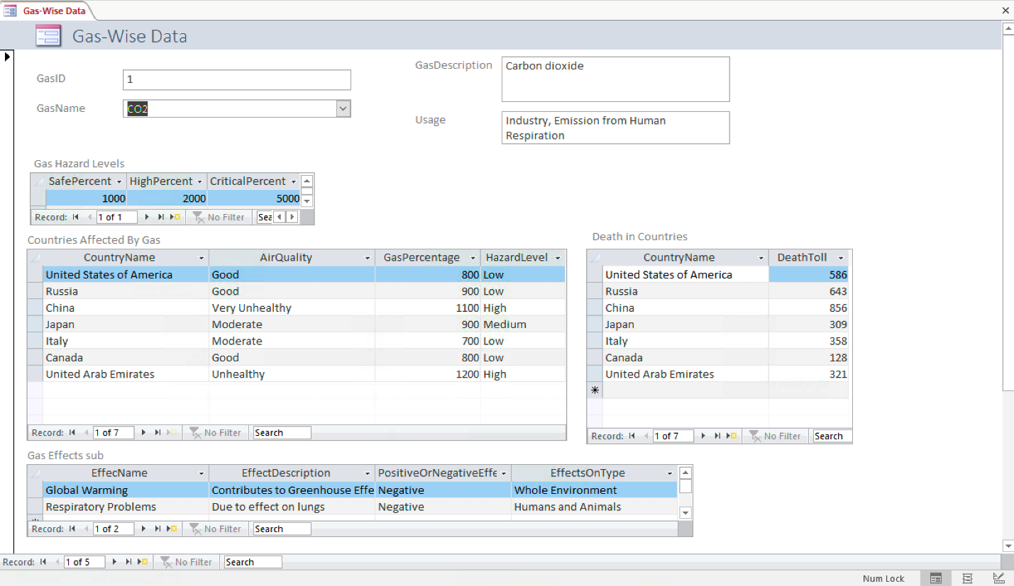
Forms
Gas-Wise Data

Slide 17
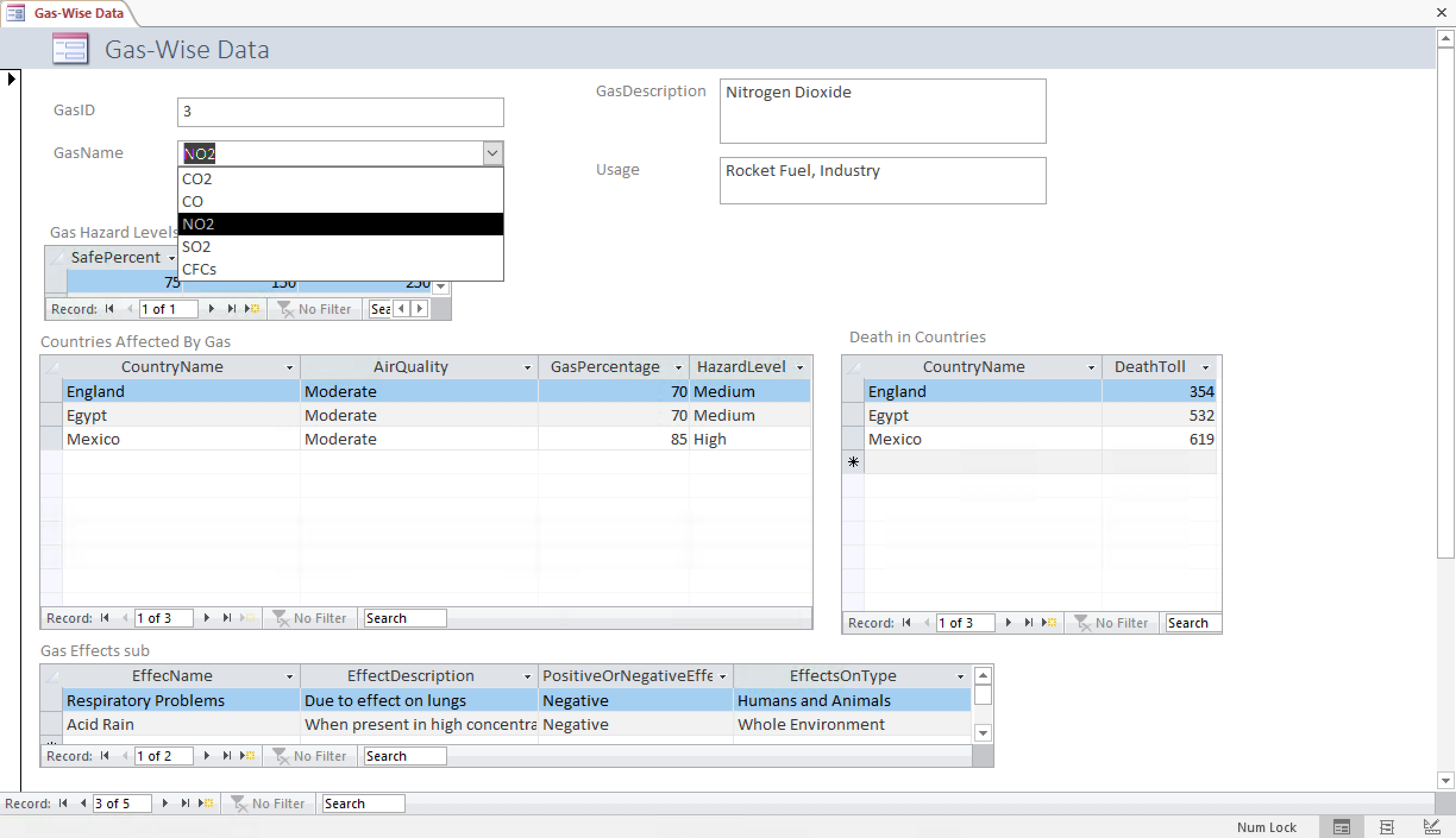
Forms
Gas-Wise Data

Slide 18
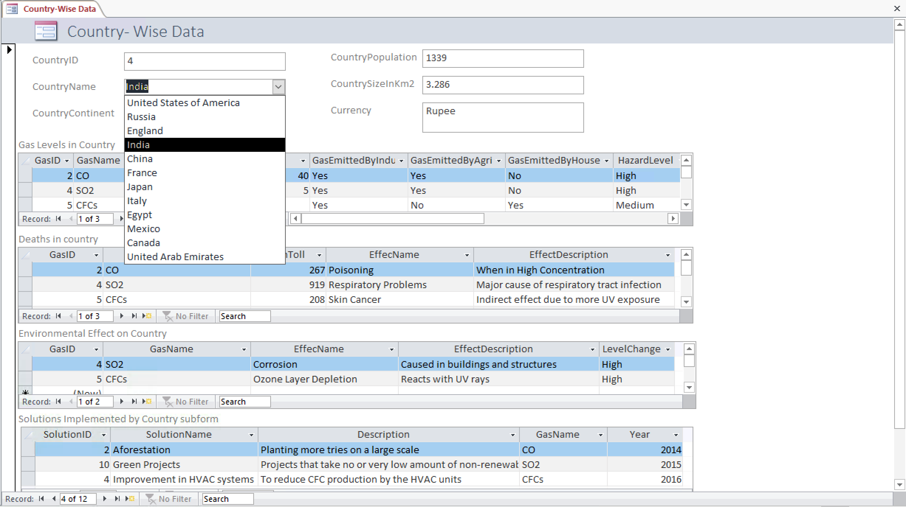
Forms
Country-Wise Data

Slide 19
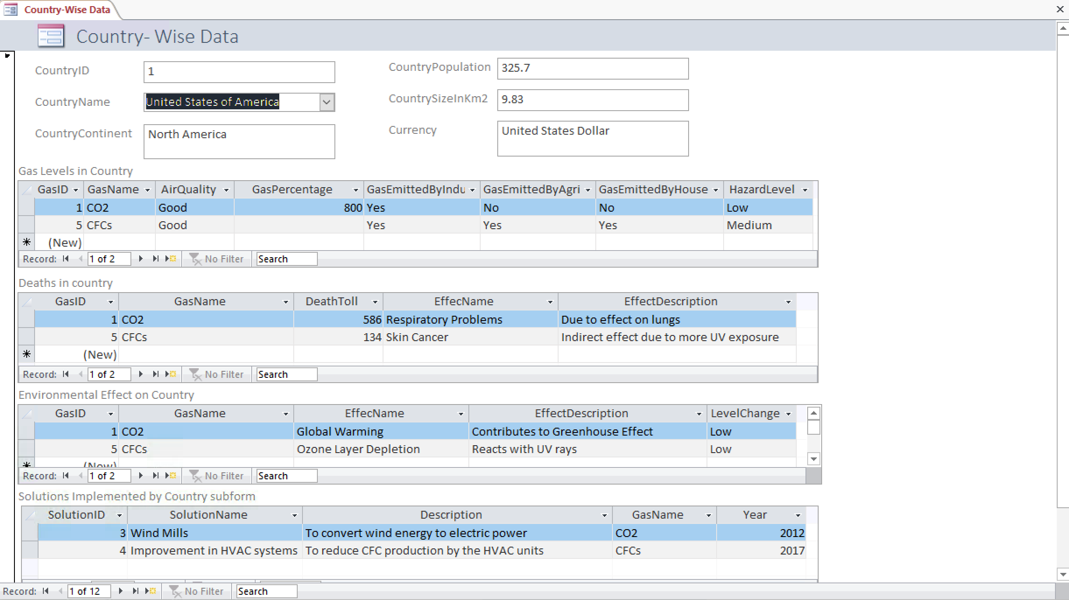
Forms
Country-Wise Data

